Slide 1
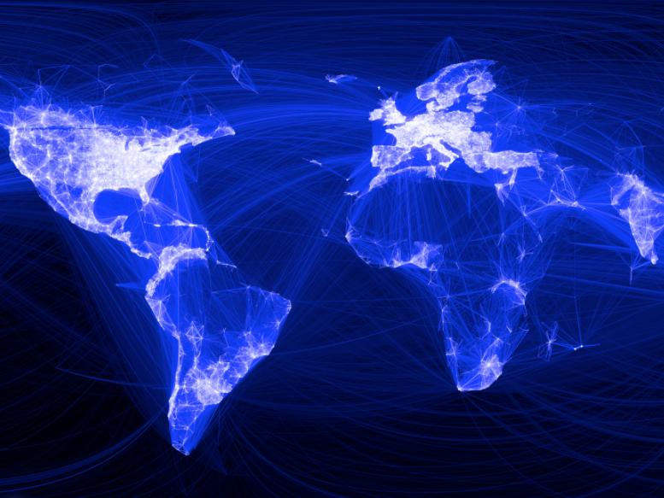
Facebook User Behavior Analytics
7200 Big-Data Sys Engr Using Scala
Chenxi Hu & Nan Yang
Spring 2016

Slide 2

Goal of the project - Usage
User recommendation for specific user id based on ti-idf analysis
search associative users given a key word based on ti-idf analysis
Use graph analysis to exclude users that already associated with then given user and present final result

Slide 3
Use Case ： Utilize pages or friends recommendations for enhance user experience
Primary Actor: Product Manager
Scope: Facebook User experience division
Level: User goal
Stakeholders：
Product Manager – to get good feedback from users
Users – to get better use experience and convenient functions
Preconditions: User posted some comment and liked some page
Postconditions:
Minimal Guarantees: User get recommendation list
Success Guarantees: User get desired recommendation list and benefit from it (expand the friend list, find the platform to communicate with those who have same hobbies and etc..)
Triggers: User access Facebook page and browse his homepage
Main Success Scenarios:
Get the friends’ relationships graph based on what this user likes
Get each node’s topic based on posts
This project could evaluate what topics the user may interested in based on his posts and likes
Generate a pages or friends recommendation list for this user
Extensions
Topic that user interested in and recommendation list could be used to provide to manufacturer
Ads could be sent to aimed users based on the related topic

Slide 4

Methodology
Data Collection
Data Analysis
Data Usage - multiuser accounts
Fetch Data from Posts
Fetch Data from Likes
Determine topics based on posts (TF-IDF)
Create user relationship graph with depth of 3 based on Likes
Calculate topic similarity and overlap of Likes graph
Group similar users
Data for Analysis
User recommendation for specific user id and search associative users given a key word
Start from a specific user

Slide 5
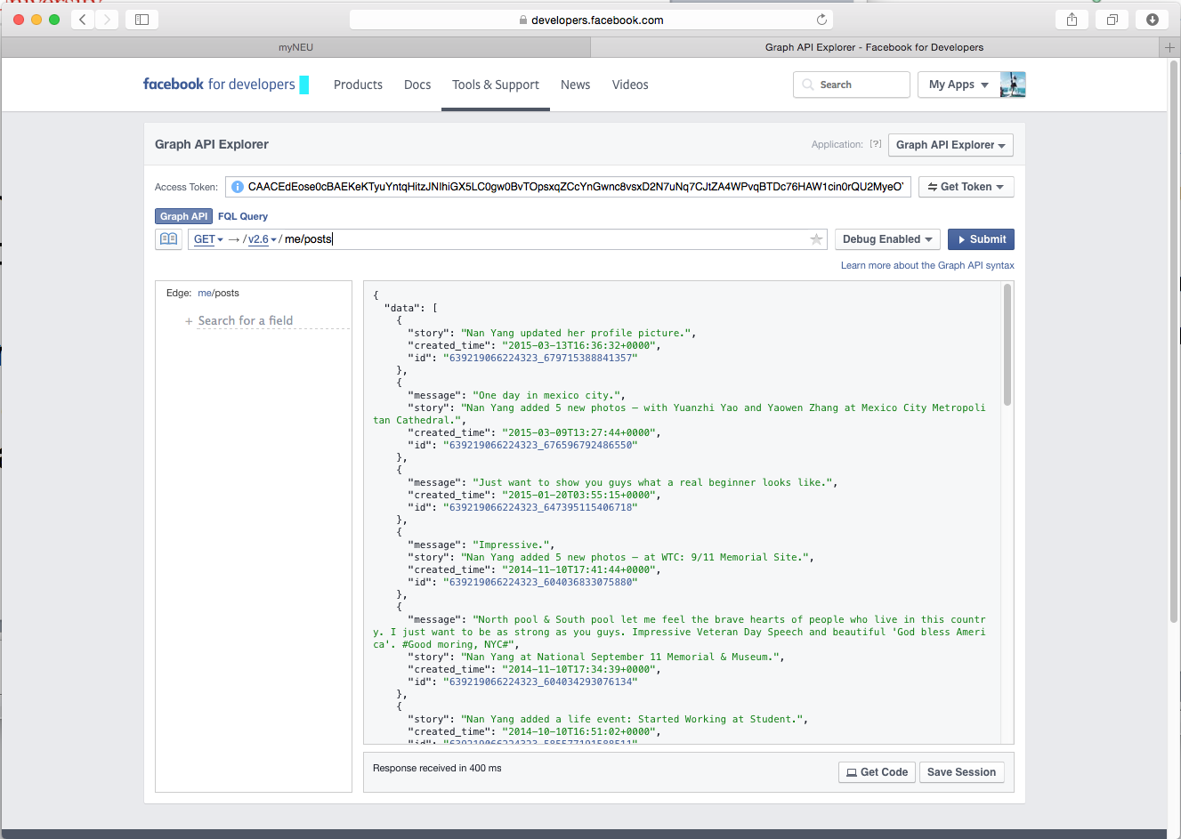
Data sources
Fetching timeline data of users from Facebook Developer API
Whole timeline Facebook posts is saved as a single text document
Graph of each user’s Likes Relationship is saved as Graph database.

Slide 6


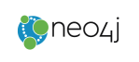




Tools involved
Function | Tools
Data Source | Facebook Developer API
Data fetching | Akka Actor
Graph | Analytics tools: Neo4j
 | Visualization: Alchemy.js
TF-IDF Analytics | Spark Mlib
 | Spark
UI | Play Framework

Slide 7
TF IDF
Term frequency and inverse document frequency
tf = single word frequency in a document / frequency of word with most occurrence
idf = Log(numbers of documents / numbers of documents containing the given word)
Tf-idf = tf * idf

Slide 8
Training a TF-IDF model
HashingTF transform each tokenized document into vector representation, map hash value of each token to vector of term frequency.
Train a NaiveBayes Model to predict the group a given user belongs to.

Slide 9
Training a TF-IDF model
Recommend users for a given user by calculating similarity between vector representation of users.
cosineSimi = SparseVector_A.dot(SparseVector_B) / norm(SparseVector_A) * norm(SparseVector_B)

Slide 10
Graph Analytics
Create Graph def createGraph(id:String, name:String, fbClient: DefaultFacebookClient): Unit
Iterate users based on Likes Relationship from StartNode and create graph database with n depth of layers by calling recursive function
Get common likes def findSimilarity(originalId:String, targetId:String) : Int
Use Cypher query get common likes between one user and a customer users Like graph
Get all notes in database def getAllNodes
Use Cypher query to get whole graph nodes and relationships

Slide 11
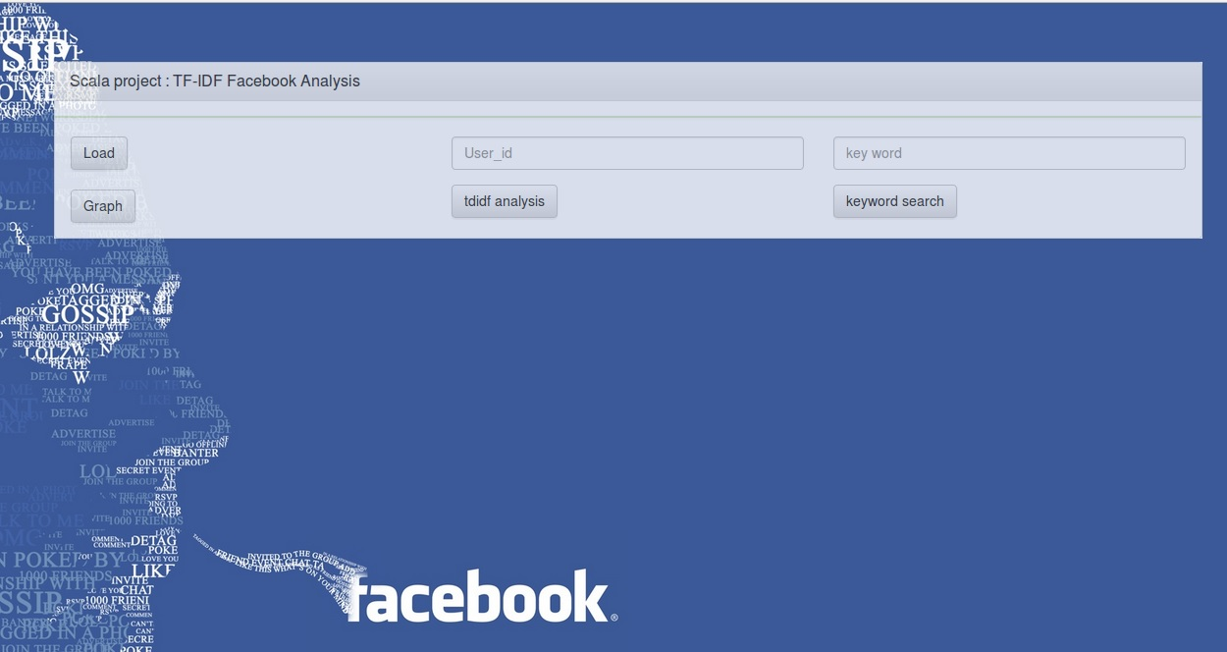
UI design

Slide 12
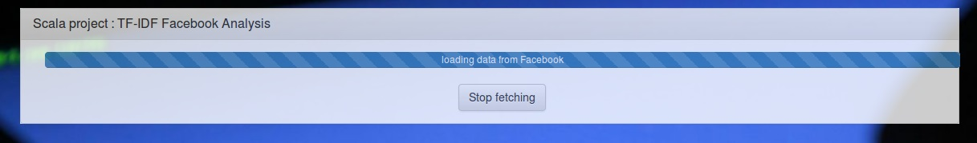
Data fetching

Slide 13
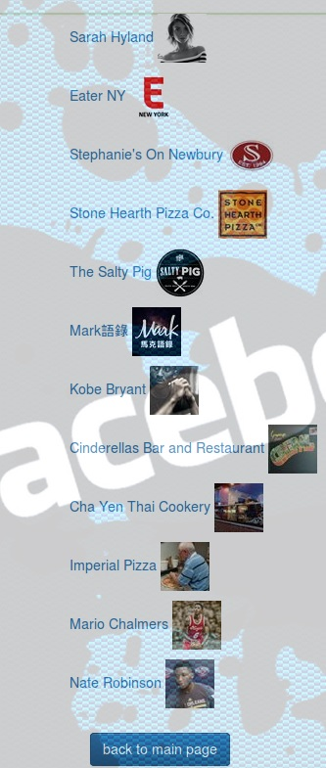
Recommend users given user id

Slide 14
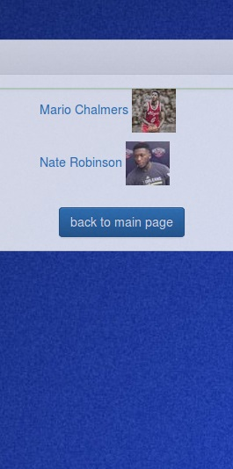
Search users based on keyword

Slide 15
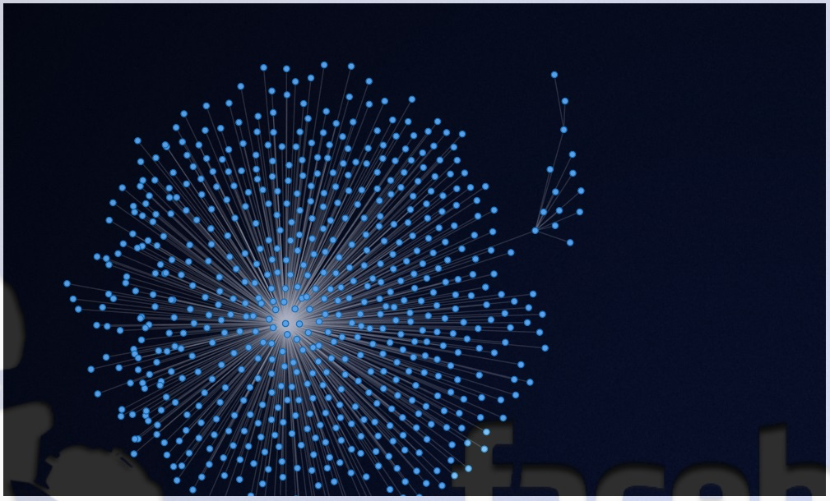
Graph Visualization

Slide 16
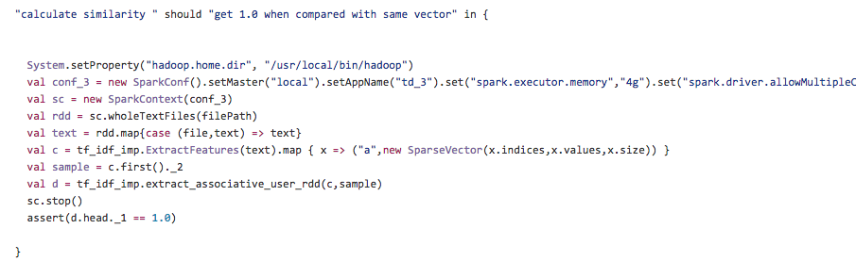
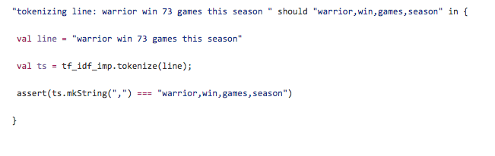
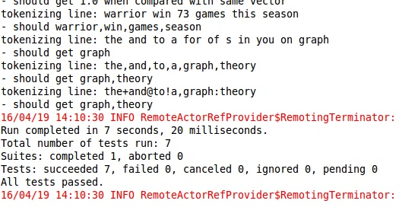
Test cases
7 test cases created to verify the result.

Slide 17

Milestones
3.23 – 3.29 Fetch Data from Facebook
3.30 – 4.05 TF-IDF analysis
4.06 – 4.12 Build Graph
4.13 – 4.19 UI design and Extended Analysis based on graph and tf-idf

Slide 18
Acceptance Criteria
In TD-IDF analysis, words with high frequency in all documents should be weighted as 0.
Accuracy of NaiveBayesModel should be greater than 0.7

Slide 19
Thank you
for any advice and suggestion.

